Slide 1


B. Tech Final Year Project – Final Review
Employment Of ANN For Predictive Motor Maintenance And Bearing Fault Detection Using Park's Vector Analysis
Team Members:
18BIS0091 V Valli Meenaa
18BIS0132 B Aadhi Aadhavan
Guided By:
Internal: Prof. Sujatha R
External: Prof. Madiah Binti Omar
Place of work: Universiti Teknologi Petronas, Ipoh, Perak, Malaysia

Slide 2
Motivation
Predictive maintenance is an emerging concept that is gaining mainstream popularity in the field of industrial automation.
It involves constant monitoring of the machinery to understand the factors which are involved in the deteriorating health of a certain machine or system.
This allows the industry to know the instantaneous health of important machinery and conduct maintenance and shut-downs as and when necessary, without causing extensive damage to said machinery or the entire subsystem.

Slide 3
Literature Review
S.No | Title | Publication | Description
[1] | Application of Multiple Parks Vector Approach for Detection of Multiple Faults in Induction Motors | Journal of Power Electronics, vol. 17, no. 4, pp. 972-982, 2017 | Despite the fact that Park's vector approach is simple and easy to understand, it is difficult to classify multiple faults. In contrast, its extended version can easily categorize fault types but is difficult to analyse. Thus, to classify multiple faults, a new concept, Multi-layer Park's vector approach (MPVA), which combines multiple approaches, was proposed
[2] | Fault diagnosis of ball bearings using machine learning methods | Expert Systems with applications, vol. 38, no. 3, pp. 1876-1886, 2011 | The use of an ANN and a support vector machine (SVM) in bearing fault detection was explored. vibration signals were collected as the response to the diagnosis. The results show that both algorithms can be used to develop a knowledge base system
[3] | Bearing fault diagnosis using motor current signature analysis and the artificial neural network | International Journal on advanced science Engineering Information Technology, vol. 10, 2020 | Utilized an SCT013 current sensor and Arduino MEGA for the acquisition of time-domain signals, which later fed into ANN. The researchers managed to classify the motor health condition based on 360 validation data sets and findings showed that the application of MCSA with ANN is an effective method to diagnosis different bearings faults
[4] | A Data-Driven Approach Based Bearing Faults Detection and Diagnosis: A Review | IOP Conference Series. Materials Science and Engineering; Bristol Vol. 1094, Iss. 1 | Combination of statistical control charts and AI-based methods would produce a robust method for industrial fault detection
[5] | Fault Detection in Induction Motors using Park's Vector Approach and Wavelet Analysis | International Conference on Mechatronics and Control (ICMC), 2014, pp. 1064-1068 | Proposed Park's vector modulus for stator current signal using wavelet packet transform. The results demonstrated that the Park vector increased the amplitude of the fault components and eliminated the main frequency of the original current measurement signal.

Slide 4
Hardware & Software Details
Industrial 3-phase Induction Motor
Clamp Transducers (LEM RT-2000)
Rogowski Coils
BNC Female Connector
Integrator/Signal Conditioner (LEM AI-PMUL)
Raspberry Pi Debian x64
Python (SciKit Learn)
Keras
TensorFlow
Matplotlib

Slide 5
Objectives
Bearing faults account for the highest faults in the induction motor. If the faults go unnoticed, they can result in motor failure, which generates economic losses.
One of the most effective ways to understand health and efficiency is through motor current signature analysis (MCSA).
The proposed model employed MCSA by plotting Park's vector analysis graph to predict motor health. This graph would then be fed as the input to an artificial neural network (ANN) for automated classification of the healthy or unhealthy motor.
It is designed so that the proposed model's computational complexity is low enough to run on a RaspberryPi to implement an efficient industrial automation system.

Slide 6
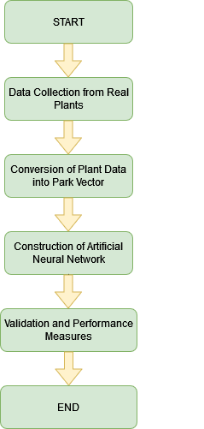
Methodology
Step 1 → Design hardware to collect data from petroleum plants
Step 2 → Analyze and pre-process collected data.
Step 3 → Convert collected data into park Vector Analysis Charts
Step 4 → Design an ANN Algorithm to classify the park Vector results.
Step 5 → Conduct intensive testing to validate performance of hardware and software entities
Step 6 → Pitch (2) the product to Petronas and other petroleum giants.

Slide 7
Hardware Development:
Design architecture for measuring IM current and providing that as input to Rpi:
This was achieved by employment of Clamp Transducers, Rogowski coils, and AI-PMUL Rogowski Integrator.
The AI-PMUL integrator reads the value provided by the Rogowski coils and maps it into a 0-5 V range, which would then be provided as an analog input to the Rpi.
Design Power Source:
The AI-PMUL demands a 24 V, 0.1 A power supply, whereas Rpi requires a 5 V input.
Currently, the MOBIT is powered by a 24 V adaptor whose voltage is regulated to 5 V to power the Rpi.
Further, the adaptor is connected to a power resistor, so as to fulfil the 0.1 A power requirement of the AI-PMUL.

Slide 8
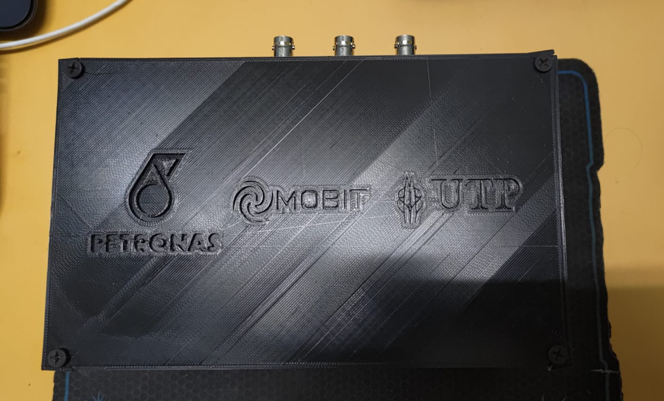
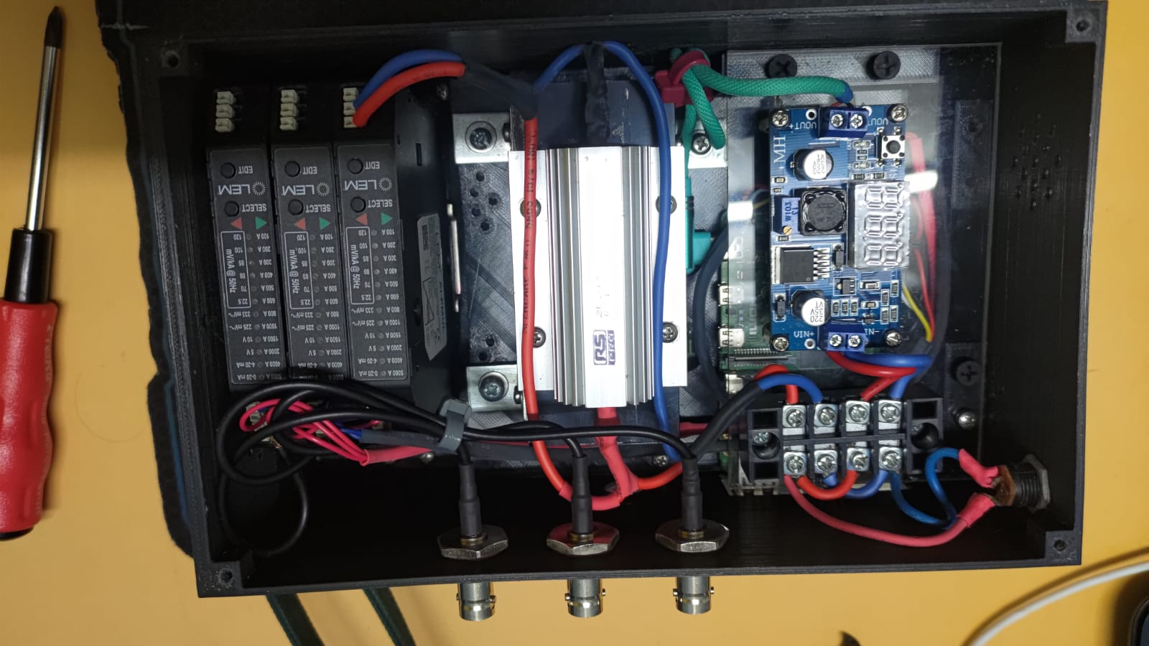
Design of External Casing
An external case was 3D printed to house the electronics, along with a touch screen display for the raspberry PI

Slide 9
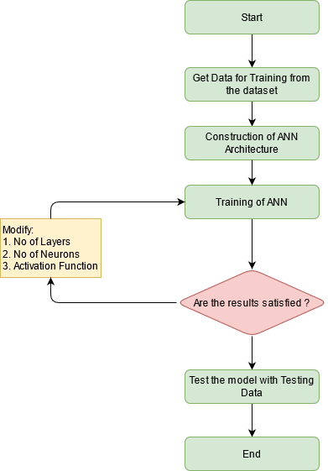
Software Development:
Design architecture for measuring IM current and providing that as input to RPi:
This was achieved by employment of Clamp Transducers, Rogowski coils, and AI-PMUL Rogowski Integrator.
The AI-PMUL integrator reads the value provided by the Rogowski coils and maps it into a 0-5 V range, which would then be provided as an analog input to the Rpi.

Slide 10
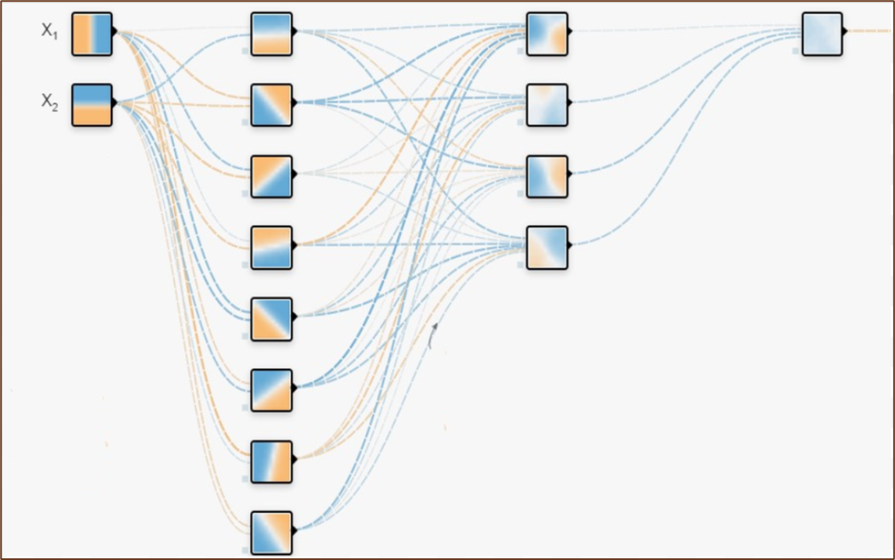
Design ANN architecture to classify the park vector results as healthy and unhealthy:
This was achieved by designing an ANN model which is comprised of 1 input layer, 2 hidden layers and 1 output layer.
An accuracy of 99% was achieved on the test set, allowing us to conduct industrial experimentation.
Deployment of ANN in Rpi:
https://docs.google.com/document/d/1n-Zx0Ha3EoofbIagziuHXbLnK4GaTMdF/edit?usp=sharing&ouid=110208802551791659043&rtpof=true&sd=true

Slide 11
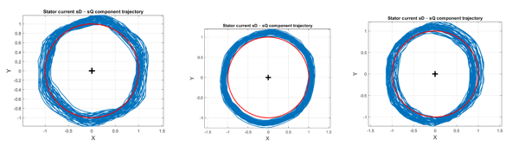
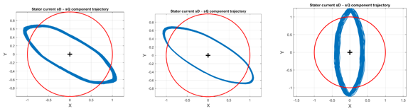
Example of data fed to the ANN
Healthy:
Unhealthy:

Slide 12
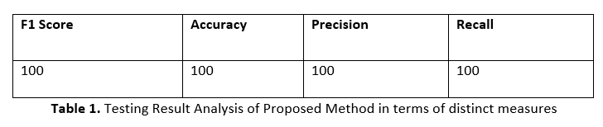
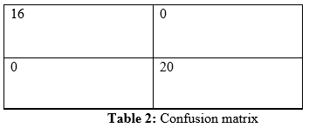
Results
ANN Accuracy
The accuracy of the ANN model on the validation and the test set was >99.99%. This is shown in table 1 below.
The confusion matrix for the designed model is as shown in table 2

Slide 13
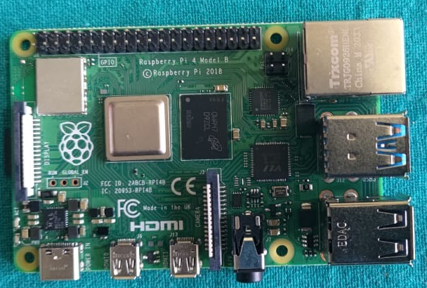
In a confusion matrix, the cell, (0,0) shows the number of true positives, (0,1) shows false positives, (1,) shows false negatives and (1,1) shows true negatives. Thus, from the above inference, we can deduce that our model has a 100% classification accuracy
Deployment of ANN in Rpi:
The ANN model was deployed in a RaspberryPI 4 Model B with 8GB RAM, coupled with a 16GB SD card. It was running the 64bit version of the Raspbian OS which is developed on Debian.

Slide 14
The model was successful deployed. Even though it was built on tensorflow and keras which is computationally intensive, the model was built to be light on the computation.
Training time on the RaspberryPI SoC: 1.3 minutes
Training time on conventional desktop: 50 seconds
Training time on cloud compiler (colab): 36 seconds
Even though the RaspberryPi takes a longer time to train the model as compared to other devices, the small physical footprint of the RaspberryPI allows us to compute on the edge, and also implement the proposed model in remote locations without the employment of expensive data transmission systems.

Slide 15
Conclusion
In the proposed work, we have developed an ANN (artificial neural networks) model for the various bearing fault segregation classification based on Park vector analysis of three-phase stator currents.
The experimental results indicate that the developed ANN model rendering 100% classification results for the dataset. It can be foreseen that the proposed method will enhance the reliability and accuracy of the methods used for the online detection and diagnosis of various bearing faults. Further this model was deployed on the RaspberryPI SoC thus qualifying it to be employed in industrial automation and related tasks.

Slide 16
Scope for Improvement
Hardware:
The power requirements of the AI-PMUL transducer requires and external power source, thus, making a handheld device impossible.
Design of a common power source for both RPi and AI-PMUL
Software:
Restricted size of dataset provided by Petronas (protected by NDA).

Slide 17
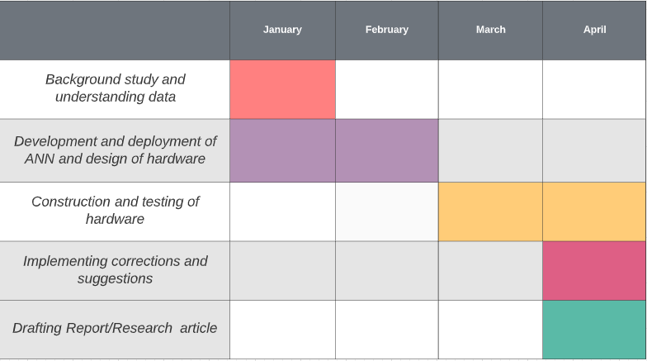
Work Timeline

Slide 18
References
T. G. Vilhekar, M. S. Ballal, and H. M. Suryawanshi, “Application of Multiple Parks Vector Approach for Detection of Multiple Faults in Induction Motors,” Journal of Power Electronics, vol. 17, no. 4, pp. 972-982, 2017.
P. K. Kankar, S. C. Sharma, and S. P. Harsha, “Fault diagnosis of ball bearings using machine learning methods,” Expert Systems with applications, vol. 38, no. 3, pp. 1876-1886, 2011.
T. A. Dhomad, and A. A. Jaber, “Bearing fault diagnosis using motor current signature analysis and the artificial neural network,” International Journal on advanced scince Engineering Information Technology, vol. 10, 2020.
S. M. Jawad, and A. A. Jaber, "A Data-Driven Approach Based Bearing Faults Detection and Diagnosis: A Review." p. 012111.
J. Zarei, and S. Yousefizadeh, Fault Detection in Induction Motors using Park's Vector Approach and Wavelet Analysis, 2014.

Slide 19
R. N. Toma, A. E. Prosvirin, and J.-M. Kim, “Bearing fault diagnosis of induction motors using a genetic algorithm and machine learning classifiers,” Sensors, vol. 20, no. 7, pp. 1884, 2020.
N. Mehala, and R. Dahiya, “Detection of bearing faults of induction motor using Park’s vector approach,” International Journal of Engineering and Technology, vol. 2, no. 4, pp. 263-266, 2010.
J. Burriel-Valencia, A. Sapena-Baño, M. Pineda-Sanchez, and J. Martinez-Roman, "Multilayer Park's vector approach, a method for fault detection on induction motors." pp. 775-780.
Wen, Long; Li, Xinyu; Gao, Liang (2019). A transfer convolutional neural network for fault diagnosis based on ResNet-50. Neural Computing and Applications, (), –. doi:10.1007/s00521-019-04097-w
S. Shashidhara, and P. S. Raju, “BEARING FAULT DETECTION OF INDUCTION MOTOR BY ANN METHOD,” 2014.

Slide 20
Thank You

Slide 21
